Slide 1
Introduction to FPGA
Adam Taylor

Slide 2
Xilinx Tools and Frameworks
VitisAI
Enables the implementations of machine learning inference, using Tensor Flow, Caffe and PyTorch. *Requires a SoC/RFSoC/Alveo
Vitis
Embedded and accelerated SW development. Used to develop software solutions for MicroBlaze, Arm R5, A9, A53 and A72.
Petalinux
Embedded Linux solutions
PYNQ
Python framework for rapid prototyping on SoC/RFSoC/Alveo
Vitis / Vivado HLS
High Level Synthesis tool supporting C/C++/OpenCL
Vivado
Design Capture and implementation for the base platform

Slide 3
Session 1
Session 2
Session 3
Session 4
Introduction to Xilinx FPGA
Processing in Xilinx FPGA
Embedded Linux
Accelerating Solutions

Slide 4
What is an FPGA
A field-programmable gate array is an integrated circuit designed to be configured by a designer after manufacturing.
Field-Programmable – Means the user can program it in the field

Slide 5
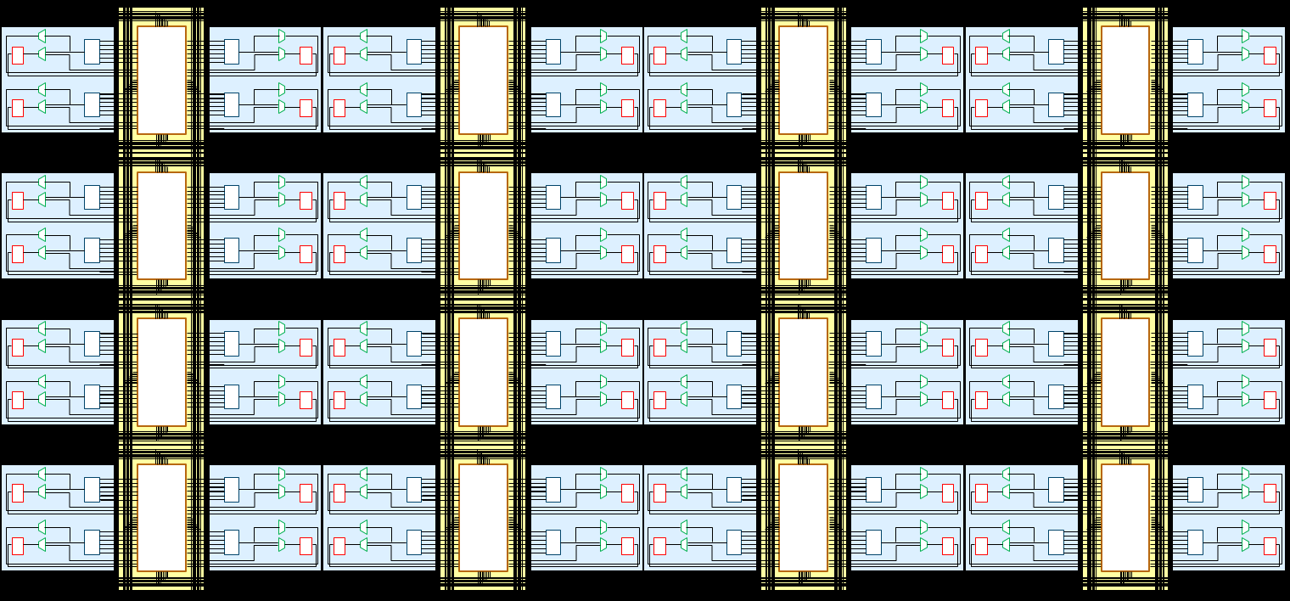
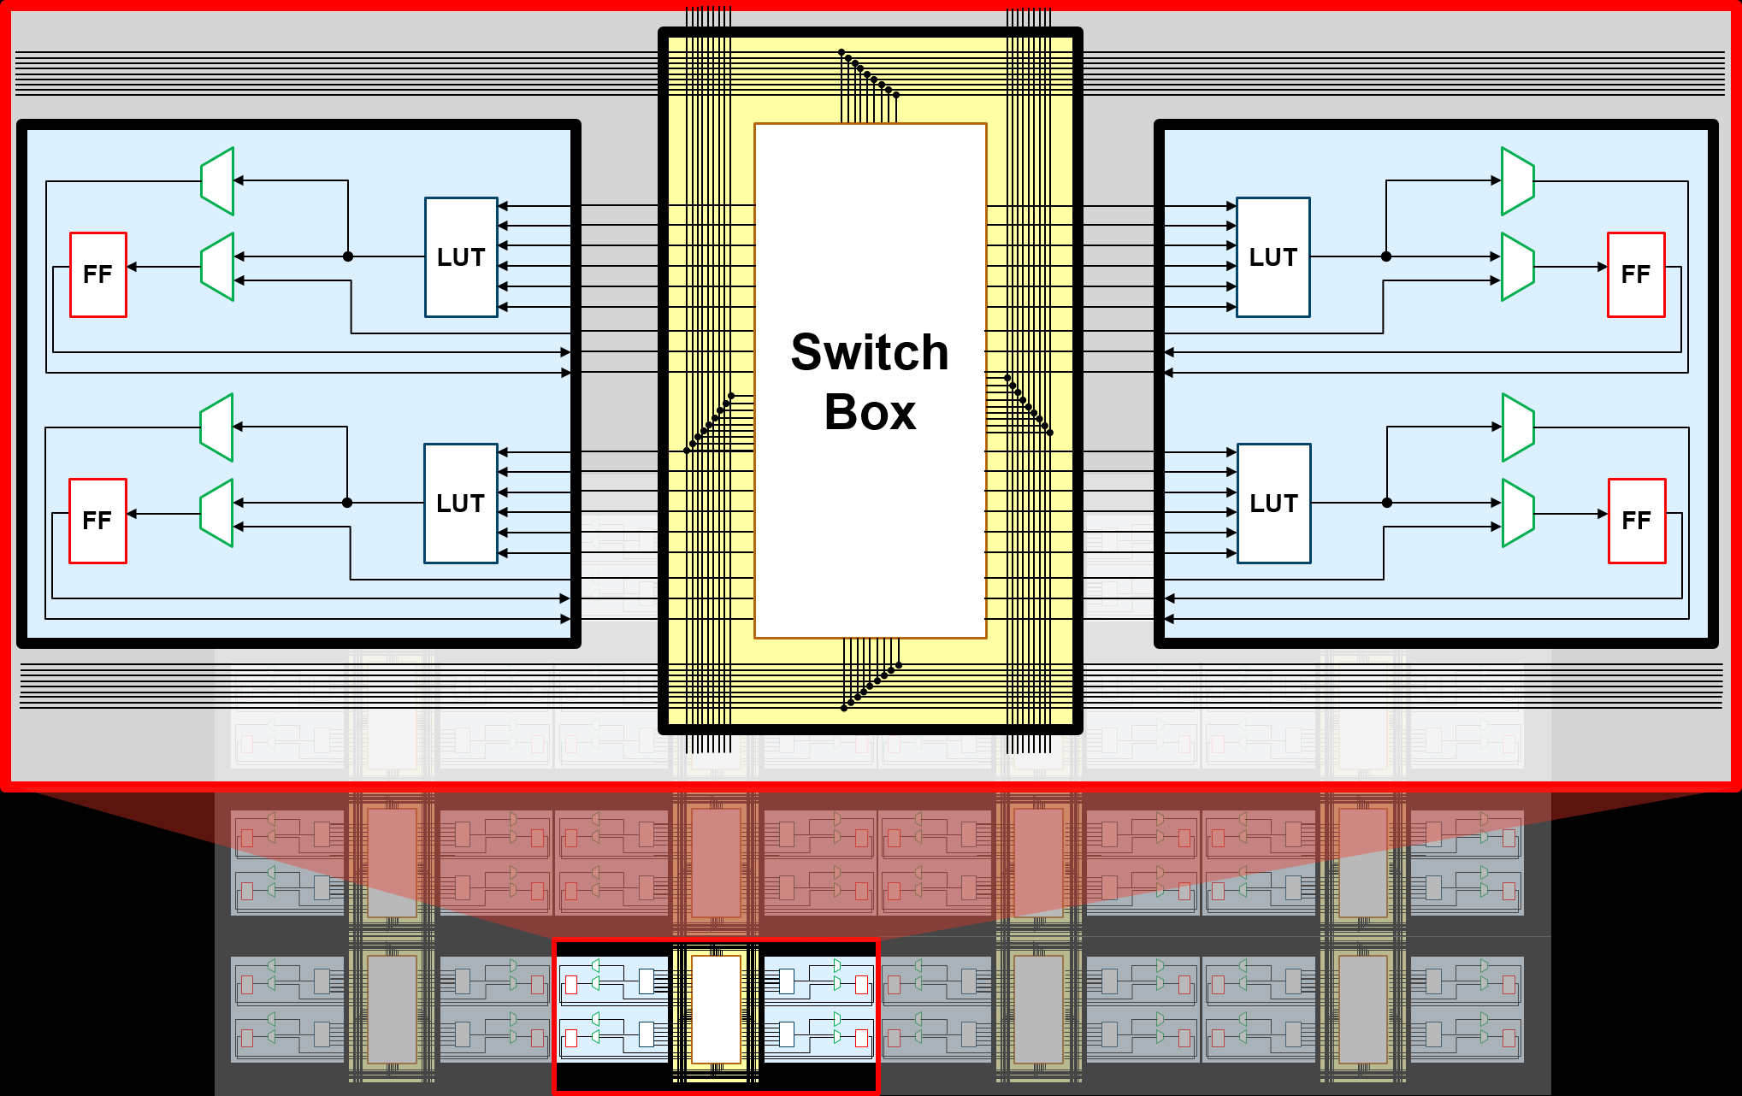
FPGA Architecture

Slide 6
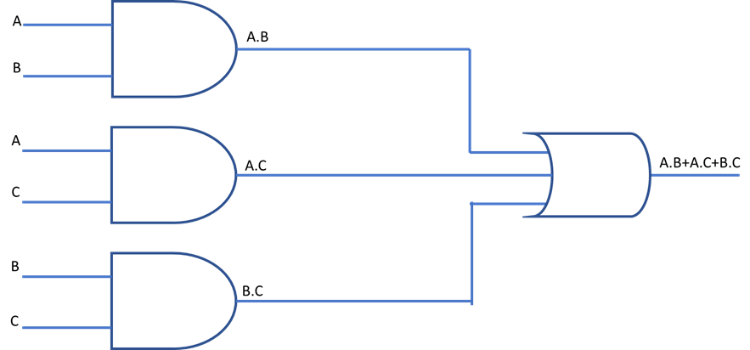
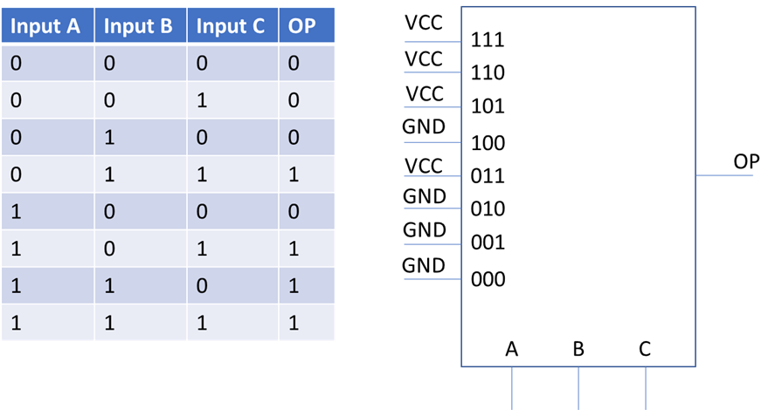
What is programmable logic

Slide 7
Look Up Table
The key to programmable logic is how logic equations are implemented in the device.
It is of course very difficult for the device designers to include a range of AND, OR gates etc. as the number of each gate type will vary for each application
Device manufacturers addressed this challenge in a very smart manner. In place of discrete gates, they used they use a several input look up table (LUT) which is programmed to implement the combinatorial logic equations.

Slide 8
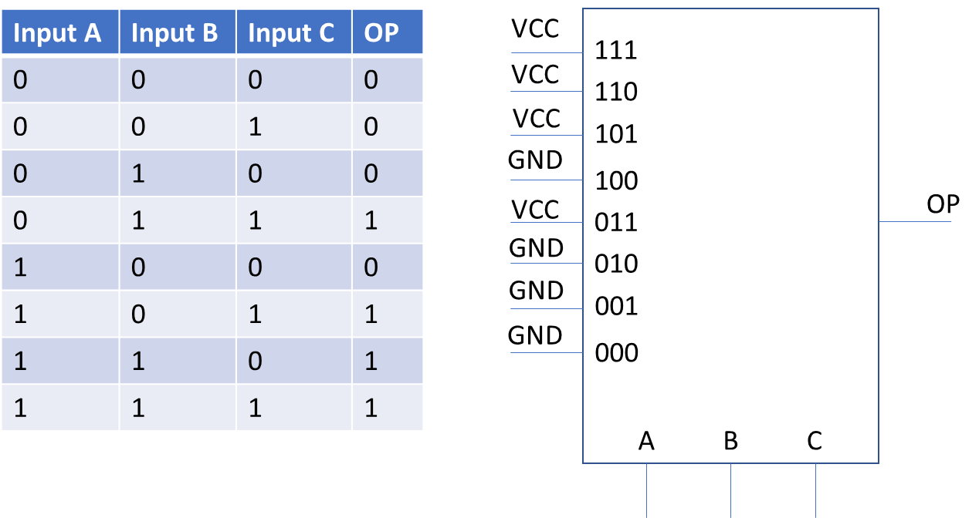
Look Up Table

Slide 9
Configurable Logic Block
LUT allows implementation of Combinatorial Circuit
BUT we design synchronous circuits what about the FF
flip flop to act as storage for the combinatorial output such that we can implement sequential structures
This combination of a LUT and Flip Flop is often called a Configurable Logic Block (CLB) and a programmable logic device will consist of many thousands of these CLBs. To provide the most flexibility additional multiplexers will be used to support a wide range of CLB configurations.

Slide 10
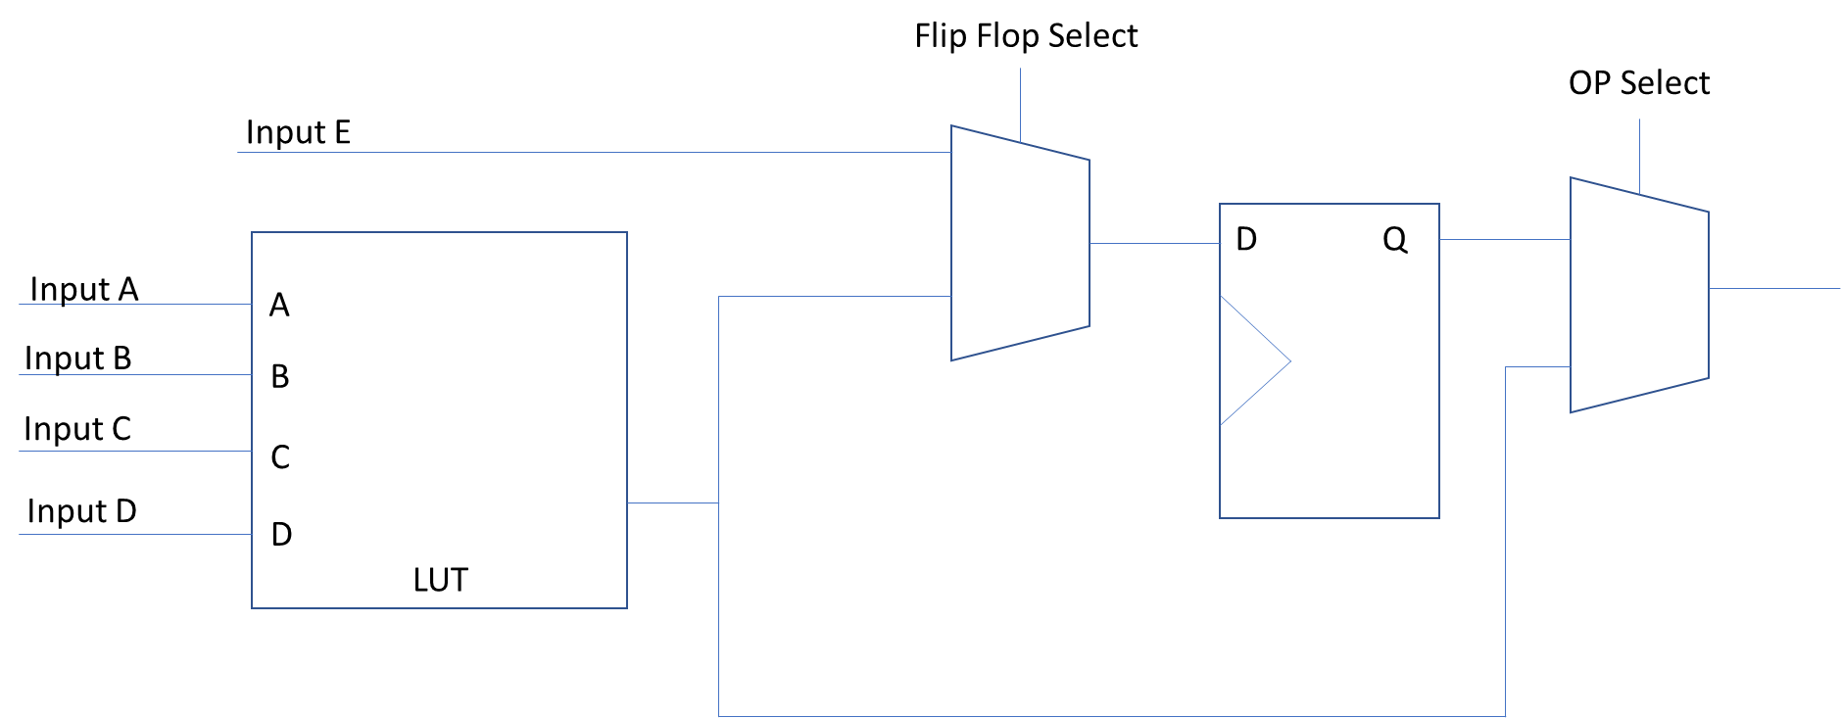
Configurable Logic Block

Slide 11
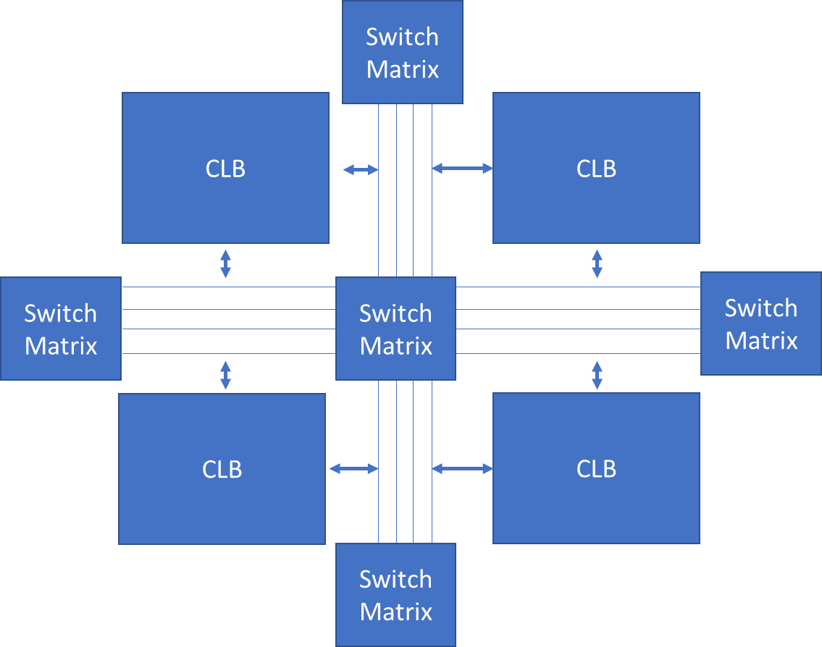
Interconnect Routing
A collection of wires and programmable switches.
These are responsible for connecting CLBs and other building blocks within the FPGA.
These are also called routing channels.

Slide 12
Tools
Requirements Capture tool
Editors – Ideal with ability to LINT and check structural issues e.g HDL Creator
Synthesis Tool – Third Party or Vendor Supplied
Implementation – Vendor supplied – some open source for lattice
Simulation – Third Party or Vendor
Source Control – Subversion, GIT
Configuration control – often called PLM tool
Specialist e.g. Fault Injection

Slide 13

Vivado Overview
Foundation of all design and higher-level tools is Vivado
Vivado enables us to capture designs using VHDL or Verilog
Large IP library to accelerate our designs
Integrates Vivado / Vitis HLS IP cores
Simulate designs using Vivado Simulator
Synthesize, place and route the design
Generate power estimations
Create Xilinx Support Architecture

Slide 14
Vivado Overview
FPGA Implementation Flow
Synthesis – Translates the HDL design into a series of logic equations which are then mapped onto the resources available in the target FPGA.
Synthesis – Place – The logic resources determined by the synthesis tool are placed at available locations within the target device.
We can control the flow implementation settings by using Constraints (XDC file) and implementation Strategies
Routing – The placed logic resources in the design are interconnected using routing and switch matrixes to implement the final application.
Bit File – The generation of the final programming file for the target FPGA.

Slide 15
Xilinx Devices

Slide 16
Xilinx Offer a range of devices
FPGA – Spartan, Artix, Kintex, Virtex – Seven / UltraScale / UltraScale+
Heterogeneous SoC – Zynq, Zynq MPSoC, RFSoC
Adaptive Compute Acceleration Platform– Versal
Accelerator Card - Alveo

Slide 17
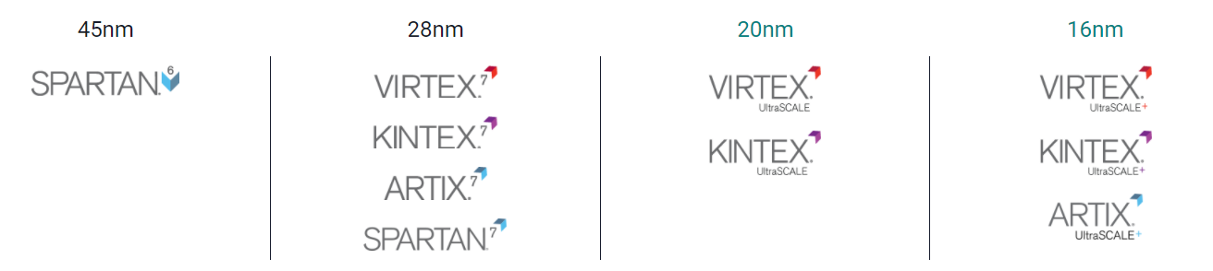
FPGA
Device Capacity
Bandwidth
Fmax
ISE
Vivado / Vitis / Petalinux

Slide 18
Heterogeneous SOC
Combine diverse processing elements with programmable logic
Processing elements are silicon implementations
Processing element is the master – it boots just like any other processor
Enables highly optimized solutions be implemented using processor and logic to exploit natural strengths

Slide 19
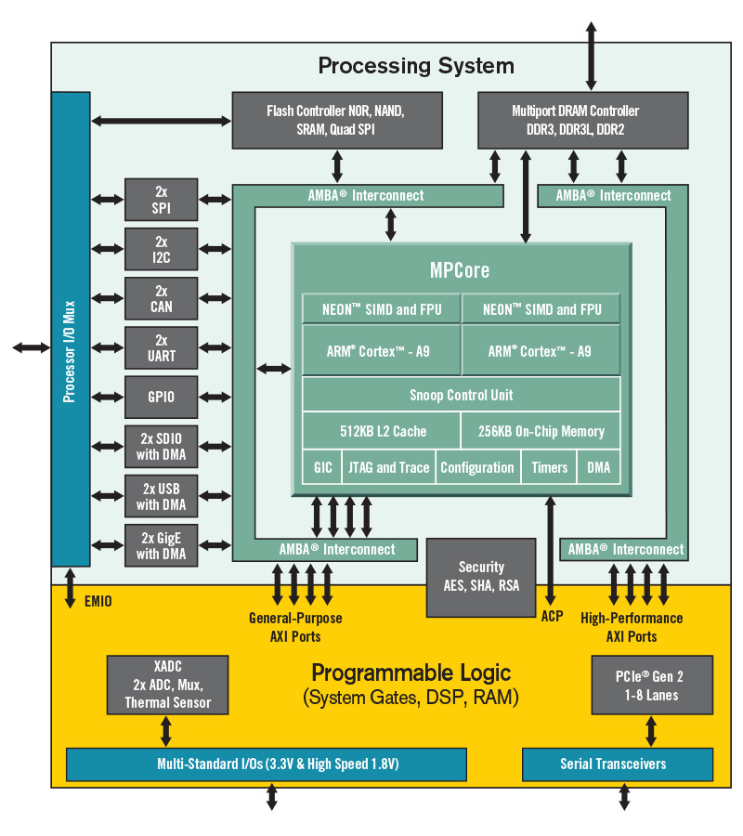
Zynq

Slide 20
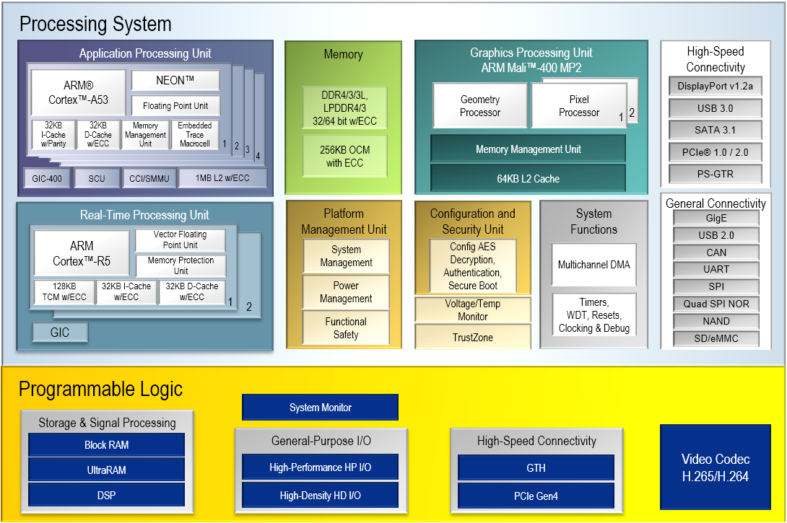
Zynq MPSoC

Slide 21
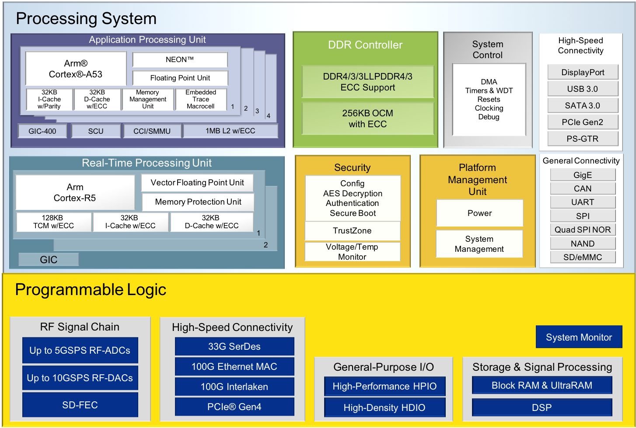
Zynq RFSoC

Slide 22
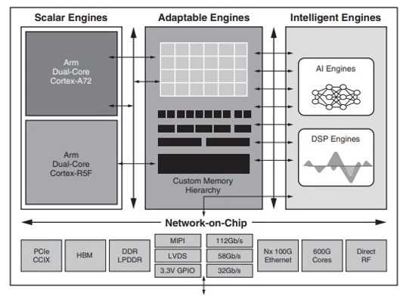
Versal

Slide 23
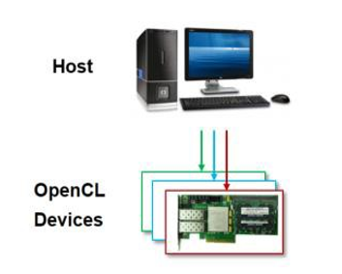
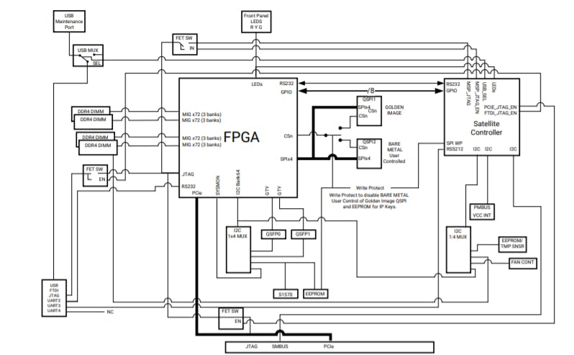
Alveo
Accelerator card based around OpenCL

Slide 24
Clocking

Slide 25
Clocking
FPGA Designs are Synchronous!
Clocks are high fan out, as such dedicated pins are required to be used.
FPGA typically will have multiple clock regions
Clock pins are places in IO banks
UltraScale / UltraScale+ GC pins or global clock pins
Seven Series CC and GC pins – GC global clocks CC restricted to close CR
Special Clock pins e.g. Byte-Lane Clocks (DBC and QBC) typical in memory applications

Slide 26
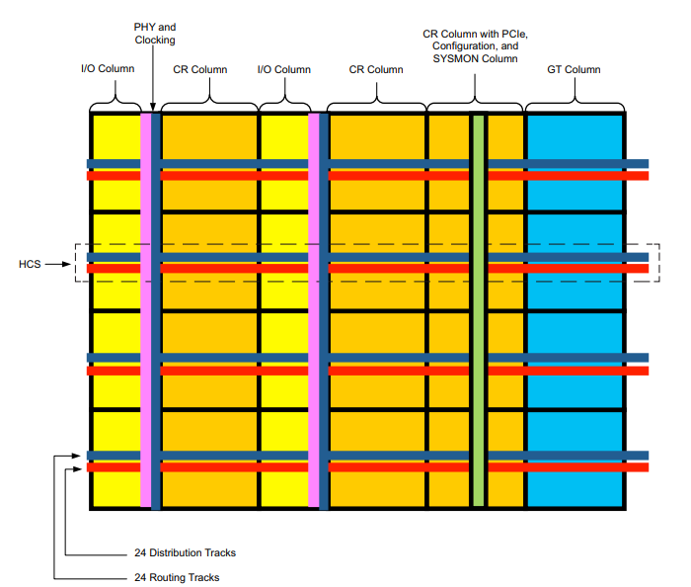
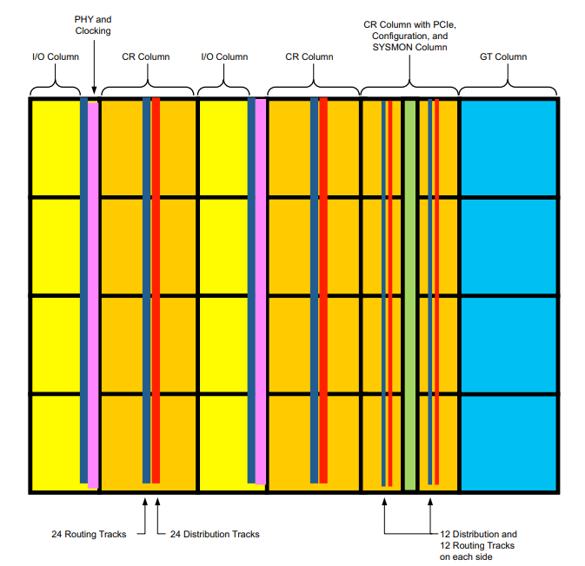
Vertical and Horizontal Clocks

Slide 27
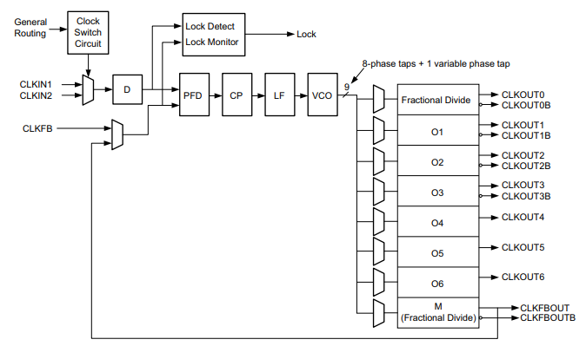
Clocking Resources
FPGA have a range of clock resources to simply solutions
Clock Buffers e.g. bufgctl
Clock Management Tiles
Mixed Mode Clock Manager (MMCM) & 2 Phase Locked Loops

Slide 28
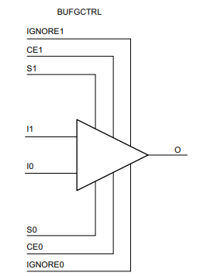
Clocking Resources
Bufgctl - drive the routing and distribution resources across the entire device.
Can switch between 2 clocks seamlessly.
Basis of many structures including
Bufgce_1, Bufgmux etc.
Read Seven Series, UltraScale clocking guides

Slide 29
What is a Clock Domain?
Same clock domain if:
Same source and integer multiple frequencies
Different clock domain if:
Different source
Even if frequency specification is the same!
All specifications have error bars
Not integer multiple frequencies, even if same source
By default, Vivado assumes all clocks are in the same domain – Unless you tell it otherwise! Not telling it clock relationships can make a significantly longer implementation times as Vivado tries to close timing which is impossible

Slide 30
Clock Domain Crossing

Slide 31
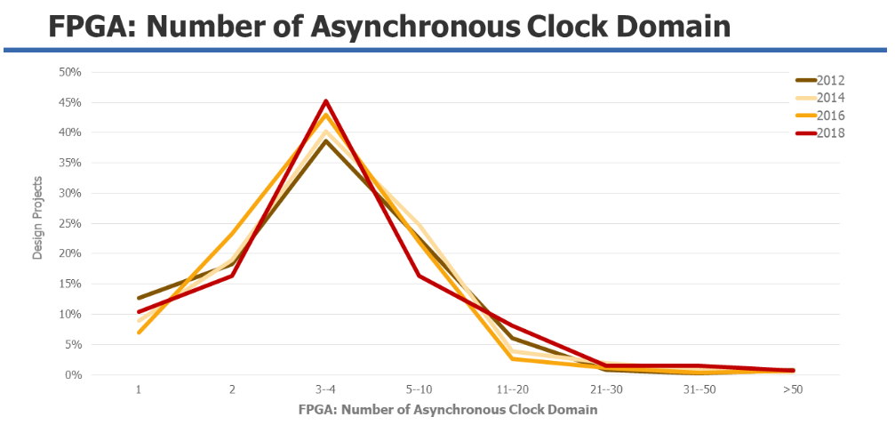
Clock Domain Crossing
Ideal solution uses one clock and the entire design is synchronous.
BUT!
Modern devices have multiple clocks to address different clock domains e.g. ADC / DAC clocks, source synchronous interfaces.
Brings with it the need to transfer data, and signals safely and reliability between the clock domains

Slide 32
Metastability
One issue which can arise with incorrect domain crossing is metastability
This can lead to corruption of data or incorrect behaviour
Occurs when a flip flops set up or hold time is violated

Slide 33
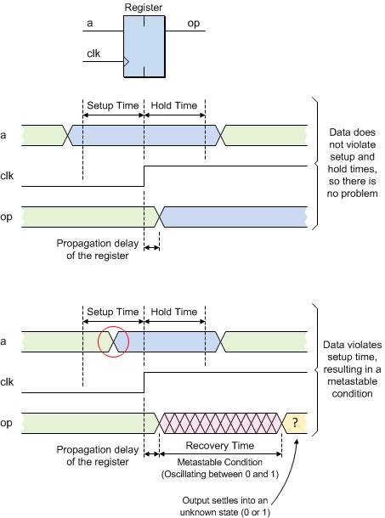

Metastability

Slide 34
Clock Domain Crossing
Several Techniques which can be used depending upon what needs to be transferred
Two stage synchroniser – Ideal for single bit data
Grey Code Synchroniser – Encodes data bus in grey code and transfer between domains – Ideal for counters as input to be converted to grey code can only decrement / increment by one from previous value
Hand shake synchroniser – Transfers data bus between two clock domains using handshake signals
Pulse synchroniser – transfer pulse from one clock domain to another
Asynchronous FIFO – transfers data from one domain to another, useful for high throughput / burst transfers

Slide 35
Clock Domain Crossing
To support reset functionality across clock domains we may need the following synchronisers structures.
Asynchronous Reset Synchroniser – enables asynchronous assertion and synchronous de-assertion.
Synchronous Reset Synchroniser – synchronises a synchronous reset to another clock domain.

Slide 36
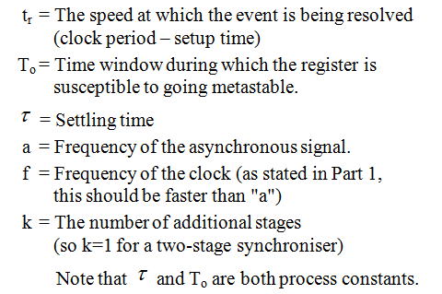

How many synchronisers do I need ?
Standard two stage synchroniser assumes the first flip flop, will recover from metastability before the signal is clocked into the second flip flop.
How do we know this is the case and what if we need more stages

Slide 37
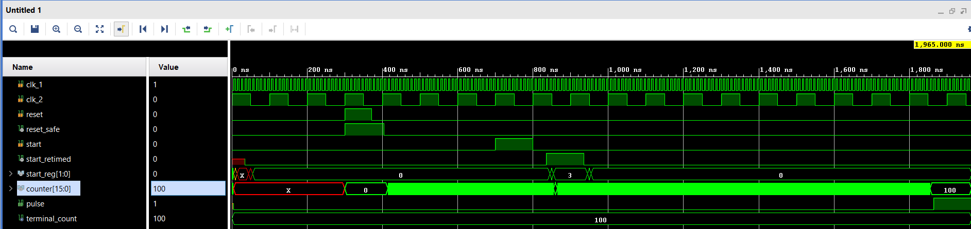
CDC in Xilinx
Xilinx Parameterised Macros (XPM) – provide CDC structures
Use registers optimised for CDC in the fabric
Registers located close together and have small set up and hold windows
Described within UG953 Libraries Guide
Described within UG 974 UltraScale Architecture Libraries

Slide 38
CDC Design Analysis tools
Detecting all CDC issues can be a challenge in large designs
Are all IP IO on the correct clock domain
Very easy to associate signal with wrong domain e.g. FIFO empty and WR clock
CDC issues can be very difficult to find changing on each start up and may be intermittent
Can be hard to find in simulation – Timing simulation required, takes a long time simulate the system
Static analysis tools are better suited to find the CDC issues.

Slide 39
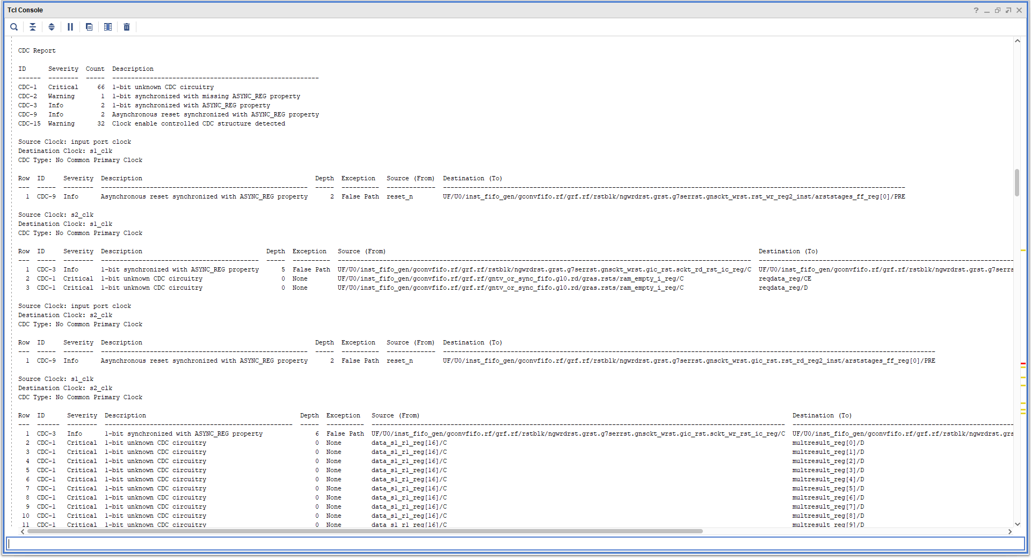
Vivado CDC Report
Following Synthesis – in TCL window run the command report_cdc

Slide 40
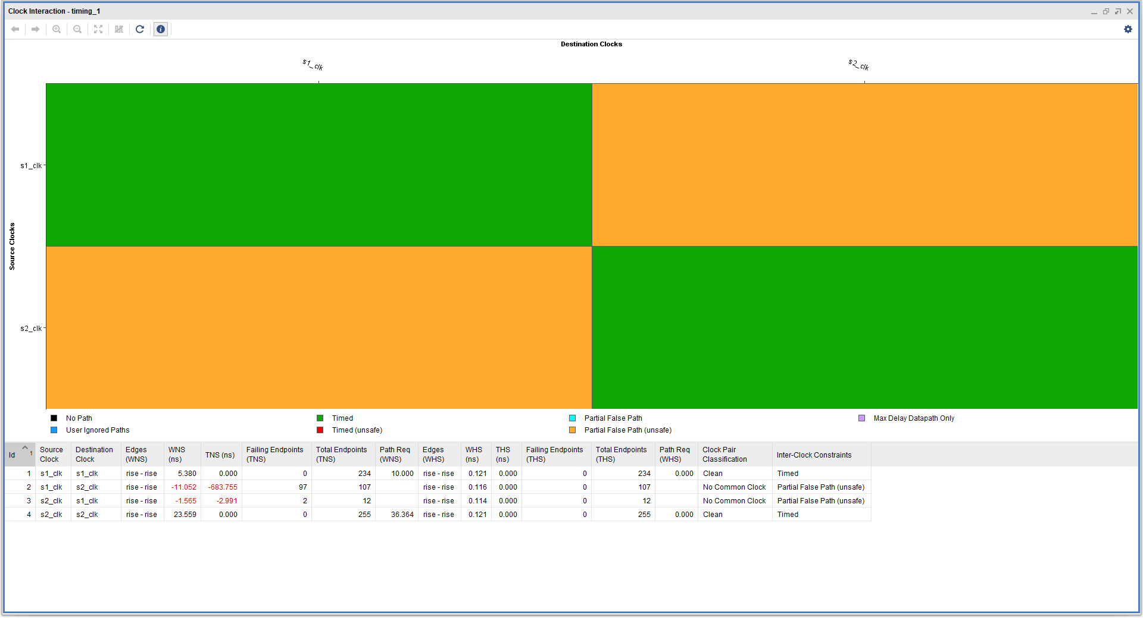
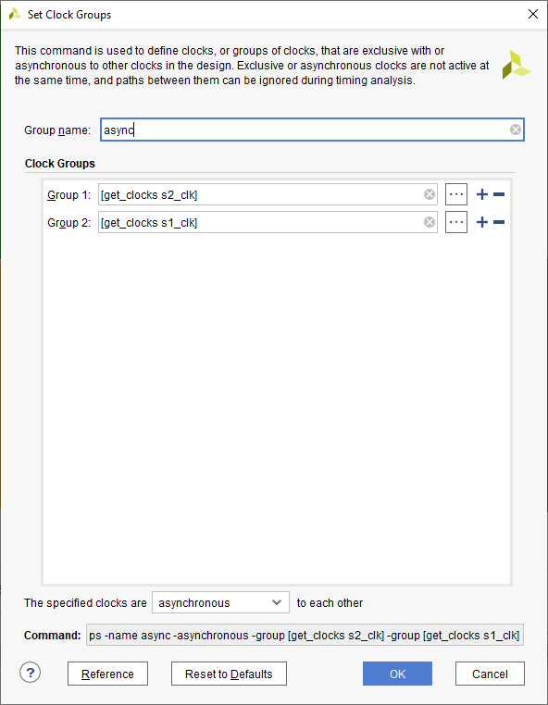
Vivado Timing Analysis – Clock Interaction
Generated From Flow Navigator when implementation is open
Yellow show unrelated clock – Indicates CDC issues as well
Means we need to define constraints

Slide 41
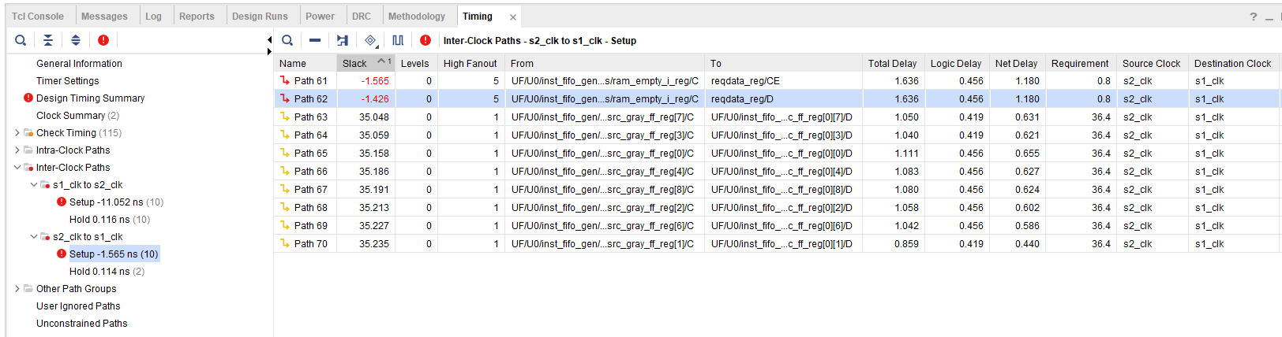
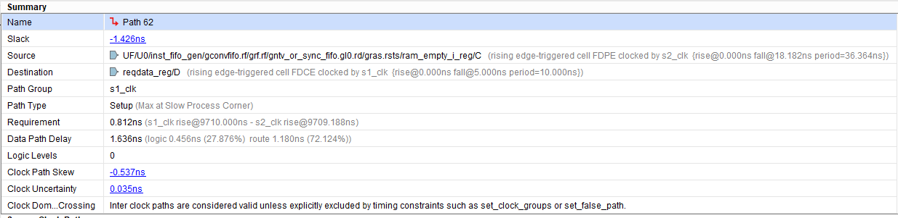
Vivado Timing Analysis – Inter clock Issues
Detailed path report – Source and Destination Clocks different
If you forget to report_cdc following synthesis. CDC issues will be apparent in the timing report if we have not correctly addressed the constraints

Slide 42
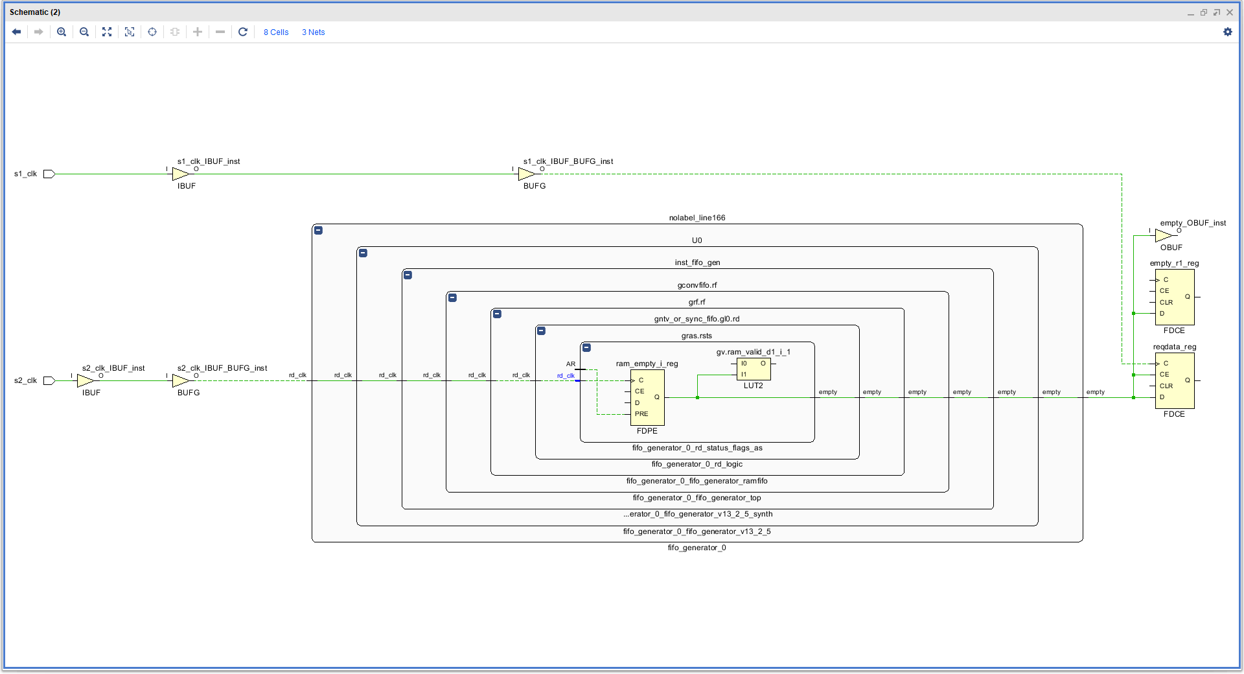
Vivado Flow - Schematic
Engineer can use information provided in the text report to navigate to the schematic to understand where CDC might be.

Slide 43
Block RAM

Slide 44
BRAM
Used for storage of the Data in the FPGA, more efficient than using registers.
BRAM can be used as Single / Dual Port – Great for clock conversion
BRAM can be used to implement FIFOs – Great for Clock Domain Crossing
What might we store in the BRAMs
Filter Coefficients
Image Lines
Signal Data
System Configuration Data

Slide 45
Block RAM
RAMS can be protected by error protection codes
Depending upon the device these are hard coded into the RAMS and transparent to the user or require user implementation
Regardless of how they are implemented it is a good idea to use a scrubbing algorithm which will read back contents out of the memory periodically and ensure correction of any errors to prevent a build up of errors
If these RAMS are being used to store the configuration of the system it is a good idea to have a copy of this configuration on the ground payload control system to ease recovery in the worse case

Slide 46
BRAM in Xilinx
Inherent support for ECC
Cannot initialise BRAM with a COE file it ECC is used
BRAM 64 bit data width and greater Hard Hamming Implementation
BRAM less than 64 bit data width soft hamming implementation
Can optimise for performance / power

Slide 47
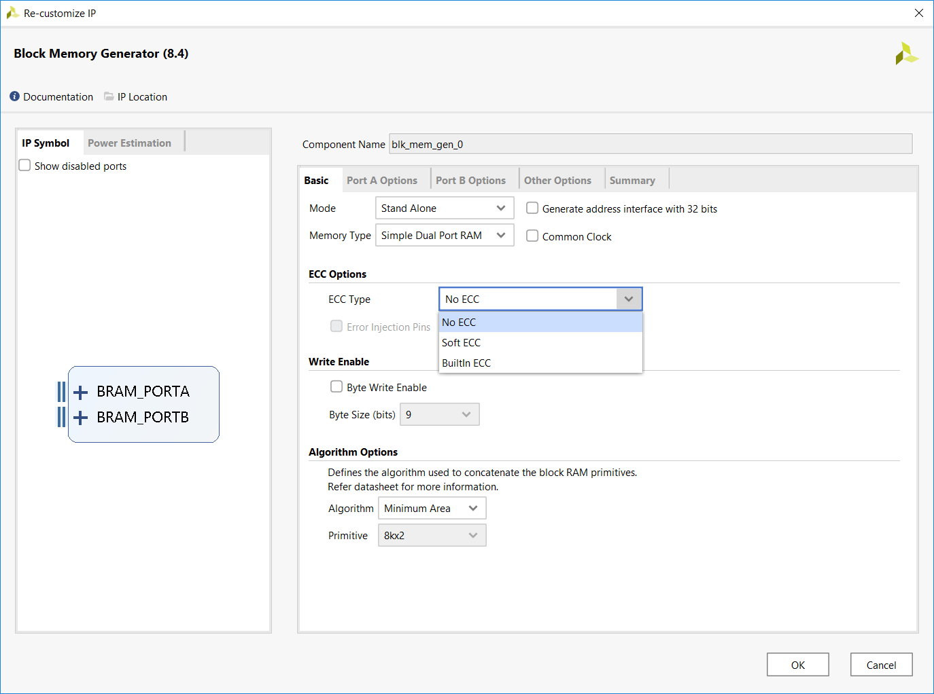
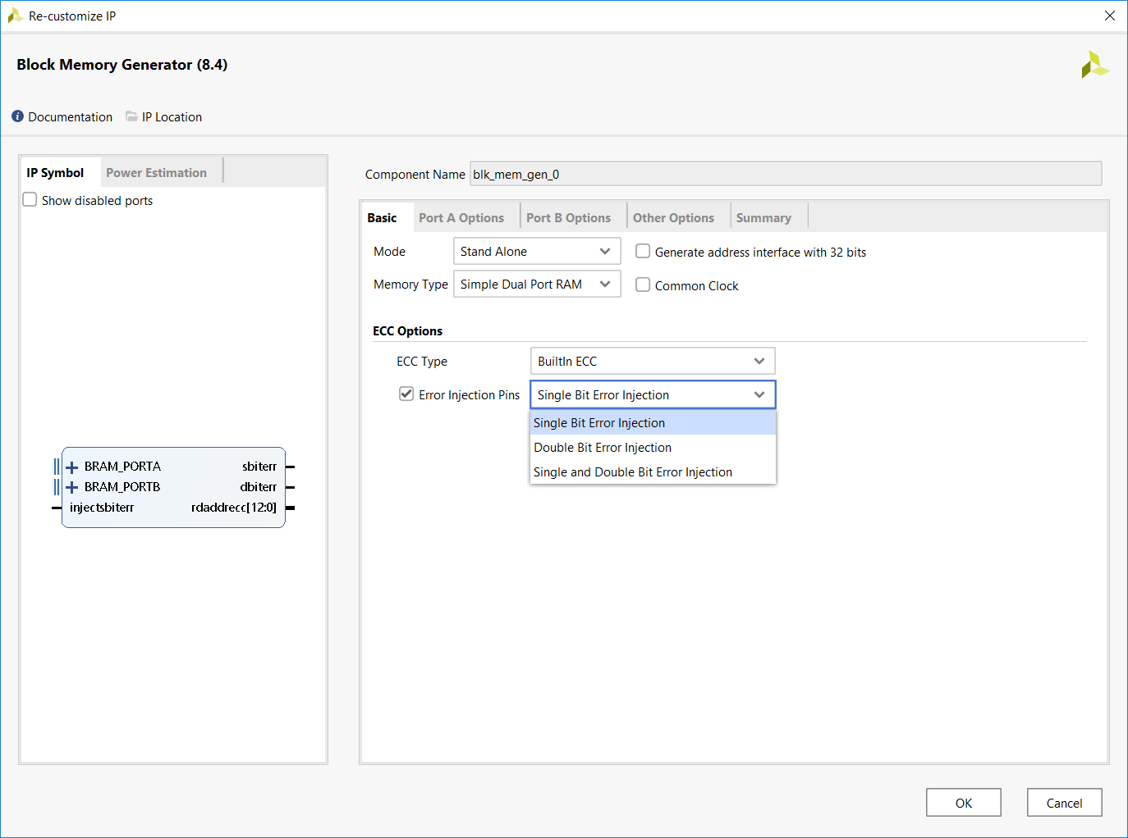
ECC In Block Memory Generator

Slide 48
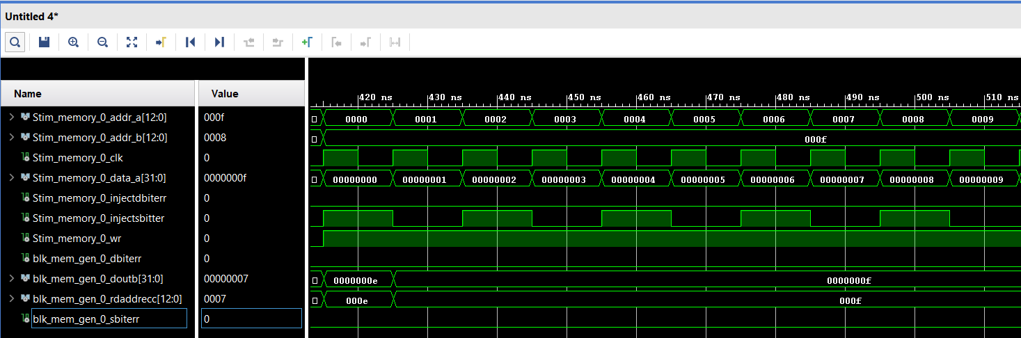
Injection of Error in to BRAM

Slide 49
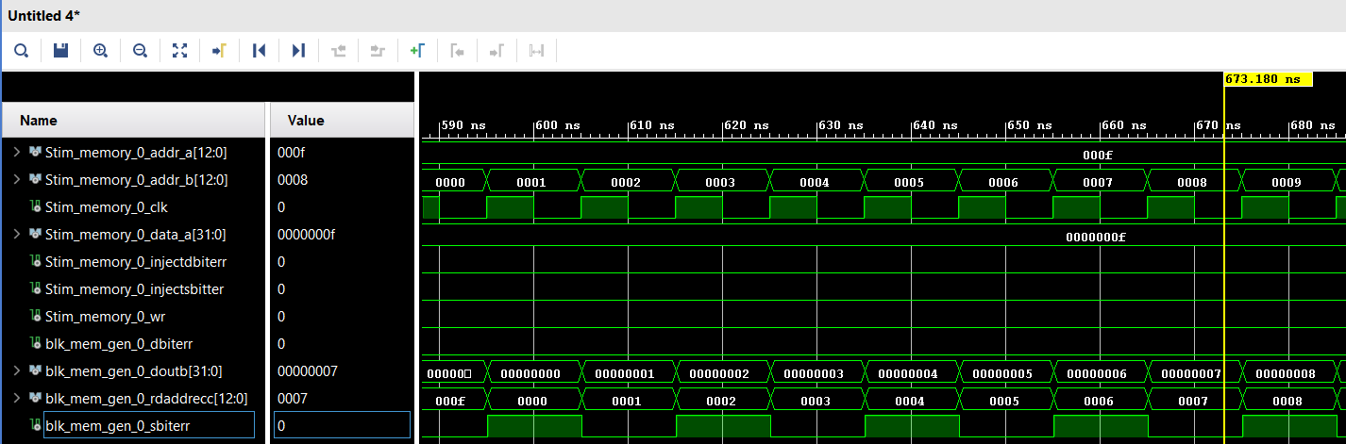
Read out of Error

Slide 50
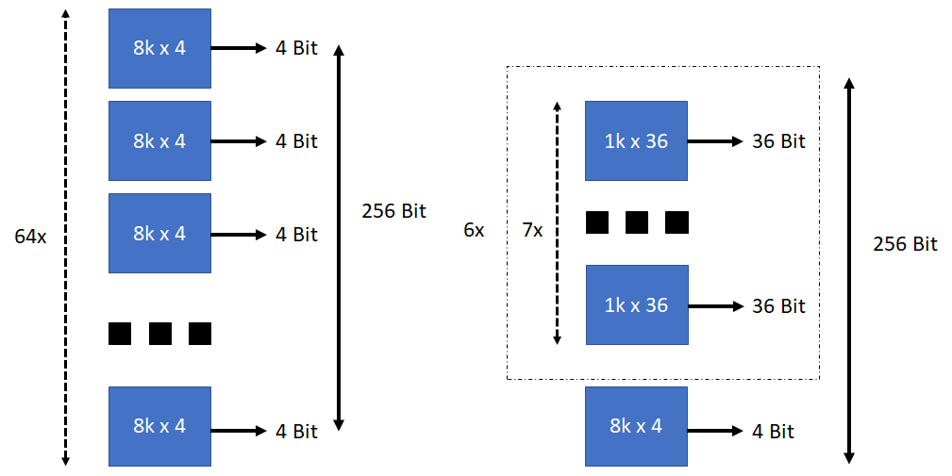
BRAM Optimisations
Optimise BRAM for power / performance
6K by 256 RAM implemented using a 64 BRAMS configured as 8K by 4 bits
7 BRAMS configured as 1K by 36 repeated 6 times + one 8k x4 using 43 BRAMS
RAM_decomposition constraint can be used for second structure
© Adiuvo Engineering and Training, Ltd. 2020

Slide 51
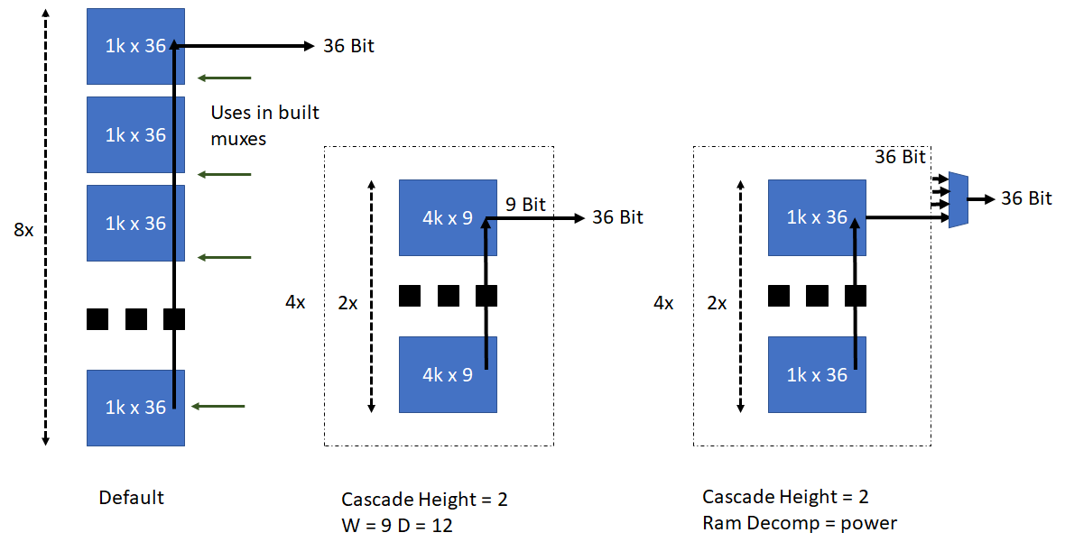
BRAM Optimisations
Can also use RAM cascade_height constraint
Not just a choice between power and performance
Also possible to combine the cascade_height and ram_decomposition
© Adiuvo Engineering and Training, Ltd. 2020

Slide 52
DSP48

Slide 53
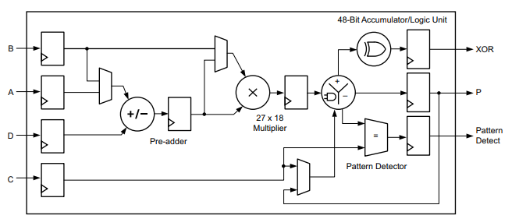
DSP
Mathematical structures such as add / subtract / Multiply / Division can be implemented in FPGA using LUT and Flip Flops
Not efficient for high performance - Better to have dedicated resources in the FPGA
Enter the DSP48

Slide 54
DSP
Applications
Fixed- and floating-point Fast Fourier Transform (FFT) functions
Systolic FIR filters
MultiRate FIR filters
CIC filters
Wide real/complex multipliers/accumulators

Slide 55
Multi Giga Bit Transcievers

Slide 56
Multi Giga Bit Transceivers
Xilinx FPGA implement high speed interfaces such as SATA, USB3, PCIe, Display port and Chip to Chip communications using MGTs
Special dedicated transceivers in the device – Normally in Quads with refence clock as well
Differential signaling and use Current Mode Logic
PMA Physical Media Attachment
PCS Physical Coding Sublayer

Slide 57
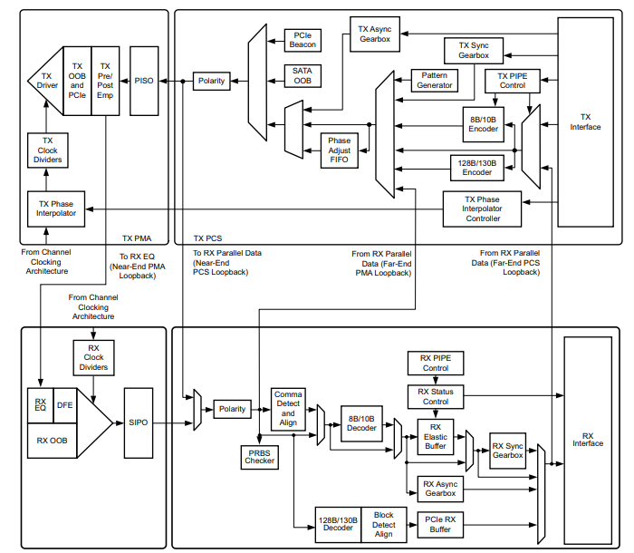
MGT Internals

Slide 58
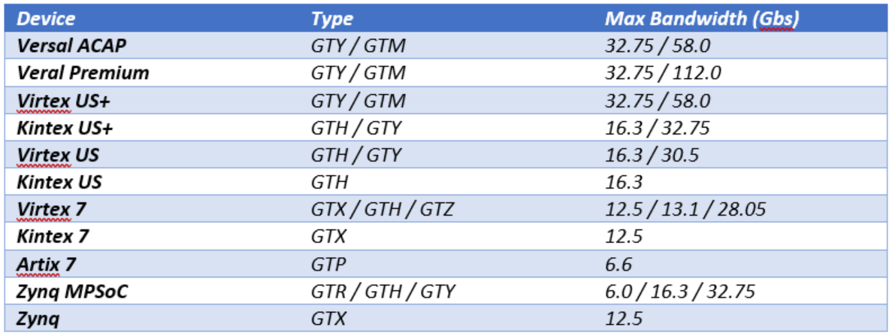
Bandwidths Supported

Slide 59
Constraints

Slide 60
Constraints
Help us instruct and guide the implementation tool
Multiple different types of constraints
Timing constraints— The timing relationships required for correct operation
Timing Exceptions— Define any exceptions to those constraints e.g. Multi Cycle Paths or False Paths
Implementation constraints—Constraints used in the design’s placement and routing e.g. IO location / type / location in the device
Device Selection

Slide 61
Clock Constraints
Vivado has several different types of clock constraints
Primary Clocks – those that enter through an I/O pin
Generated Clocks – those which are generated automatically via an internal PLL or by the design (for instance, dividing a clock by two with a flip-flop). With generated clocks, one describes how the master clock (either a prime or other generated clock) modifies the waveform
Virtual Clocks – These are not attached to anything within the design netlist but can be used for I/O timing

Slide 62
Clock Constraints
Vivado has three different types of clocks
Synchronous Clocks – Synchronous clocks have a predictable timing/phase relationship, which is normally the case for a primary clock and its generated clocks because they share a common root clock and will therefore have a common period.
Asynchronous Clocks – Asynchronous clocks have no predictable timing/phase relationship, which is normally the case for different primary clocks (and the clocks generated from these primary clocks). Asynchronous clocks have different roots.
Unexpandable Clocks – Two clocks are unexpandable if a common period cannot be determined over 1000 clock cycles. If a common clock period cannot be established, then Vivado uses the worst case set-up relationship over the 1000 cycles. However, there is no guarantee that this relationship truly represents the actual worst case. That estimate is just the best that Vivado can do with the information provided.

Slide 63
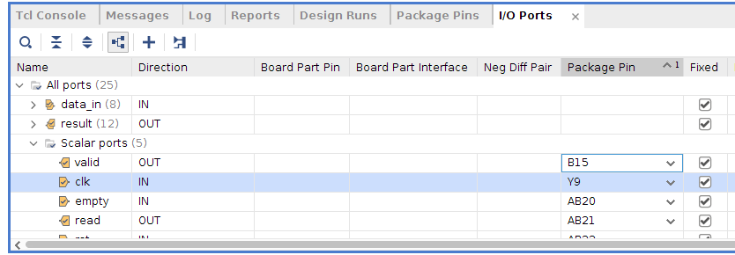
Placement Constraints
Vivado has a range of constraints we can use
Placement Constraints – define cell location
Routing Constraints – define signal routing
I/O Constraints – define I/O location and I/O parameters
Configuration Constraints – define configuration methods

Slide 64
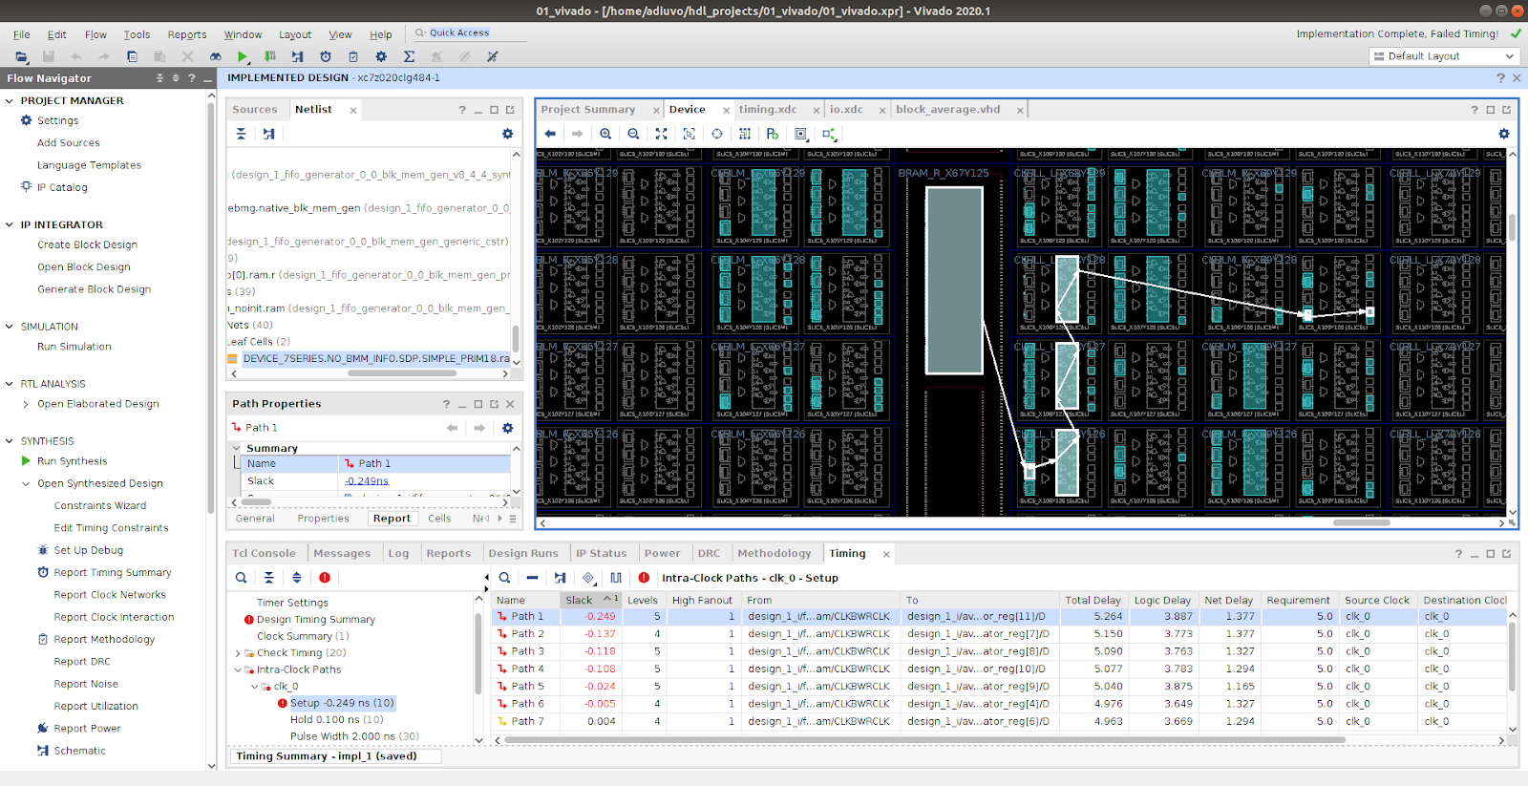
Placement Constraints

Slide 65
Device Selection

Slide 66
Benefit of FPGA
FPGA’s offer several benefits to the system designer
Flexibility of Design – performance, upgrades
Reduction in NRE and Cost.
Reliability – One Device as opposed to lots if using discrete devices - increased reliability with reduced solder connections.
Time to market can be reduced.
Maintainability – ability with some FPGA to update in the field.

Slide 67
Device Selection - SRAM, OTP or FLASH ?
SRAM: The FPGA program is stored in an external memory and loaded into the FPGA each time it is powered.
FLASH: The FLASH architecture of the FPGA also contains the program; no external memory device is needed.
One Time Programmable (OTP): The FPGA is applied by blowing fuses in the device. Once programmed, it cannot be modified.

Slide 68
Device Selection
SRAM
Higher Performance (+)
Higher Capacity (+)
Needs configuration at power up (-)
Higher Power (-)
Susceptible to Configuration Corruption (-) – but there are mitigation schemes
OTP
Live at power up (+)
Cannot be updated / fixed design (-)
Lower Power (+)
Lowest Performance (-)
Flash based
Live at power up (+)
No Configuration Corruption (+)
Updateable in the field (+)
Middling Performance (-)

Slide 69
Device Selection
Typical use cases
SRAM
Software defined radio, image processing, satellite communications, EW, AI etc.
OTP
Control and communication, security functions e.g. crypto
Flash
Control & Communication, Crypo, image processing, SDR

Slide 70
Vivado IP Integrator

Slide 71
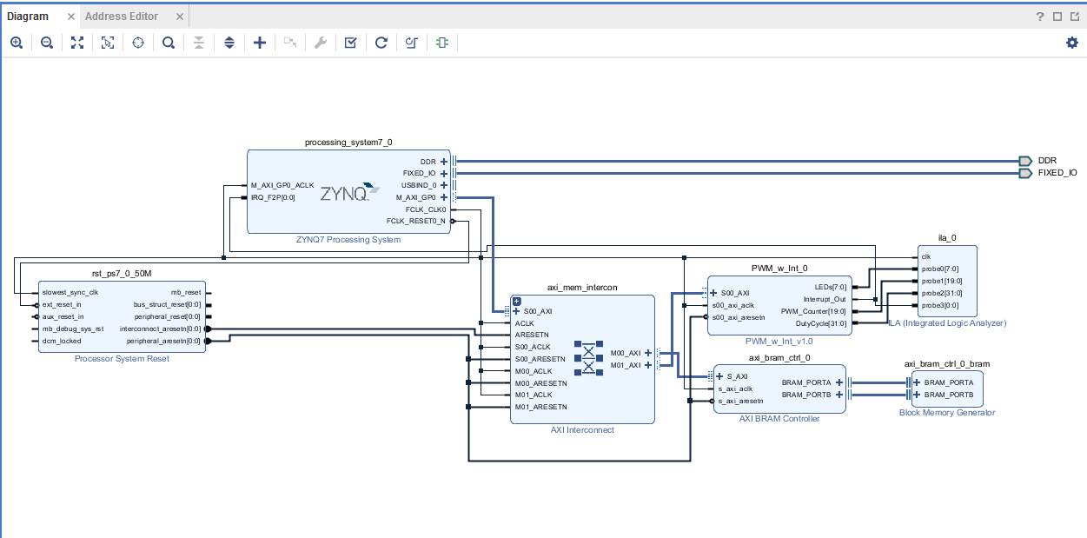
Vivado IP Integrator (IPI)
Create system-level designs
Instantiate and interconnect IP cores
IP-centric design flow
Plug-and-play IP
Vast IP catalog
Accelerates
Integration
Productivity
Example applications
Embedded
DSP
Video
Analog
Networking
Notes:
Vivado's IP Integrator builds on the foundation of Vivado's extensible IP Catalog and standards-based approach to packaging up IP.
Vivado Design Suite provides an extensible IP catalog, which can contain Xilinx, third-party, and intra-company IP that can be shared across a design team, division, or company. Vivado Design Suite leverages industry standards such as ARM®’s AXI interconnect and IP-XACT metadata when packaging IP. With IPI, Vivado Design Suite facilitates rapid development of complex systems, which can include embedded, DSP, video, analog, networking, interface, building block, and connectivity IP consolidated into a hierarchical system and IP-centric view.
With open, industry IP standards, Vivado Design Suite enables third-party vendors to deliver their IP portfolios to developers, who can integrate them with Vivado IPI. Users can also package their own RTL, or C/C++/SystemC and MATLAB®/Simulink® algorithms into the IP catalog using Vivado High-Level Synthesis (HLS) or System Generator for DSP with the Vivado IP packager.
Leveraging the extensible IP catalog, IPI provides automated IP subsystem generation, which can then also be packaged for reuse.

Slide 72
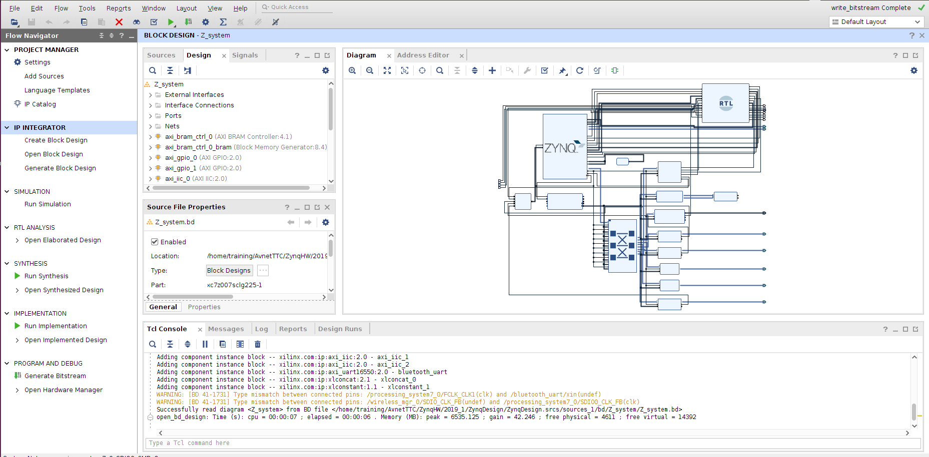
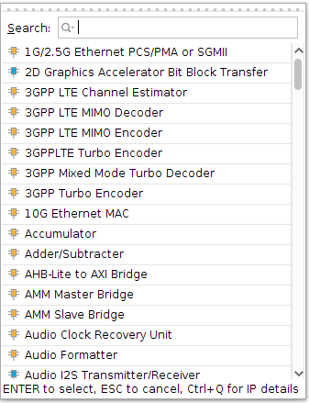

Vivado IP Integrator: Intelligent IP Integration
Automated IP subsystems
Block automation for rapid design creation
One click IP customization
Board aware
Support all 7 Series FPGAs and Zynq SoCs
Built-in presets, accelerating design creation
Hierarchy Support
System Hierarchy View
Interface Connections with Live DRCs
Tcl Console
Extensible IP Catalog
Notes:
Built on the foundation of the Vivado integrated design environment, the IPI feature provides a device and platform aware, interactive environment that supports intelligent auto-connection of key IP interfaces, one-click IP subsystem generation, real-time DRCs, and interface change propagation, combined with a powerful debug capability.
With IPI, design is correct-by-construction. Working at the interface level, design teams can rapidly assemble complex systems and leverage Vivado tools to ensure that designs and IP are configured correctly. IPI’s built-in automated interface, device driver, and address map generation accelerates design assembly. Getting from concept to debug has never been faster.
Leveraging the extensible IP catalog, IPI provides automated IP subsystem generation. As an example, to generate a MicroBlaze™ subsystem, a designer selects the MicroBlaze core, adds it to the design, and then uses IPI’s built-in block generation feature and one-click IP customization to rapidly configure the interconnect, peripherals, memory map, and device driver information to increase designer productivity.

Slide 73

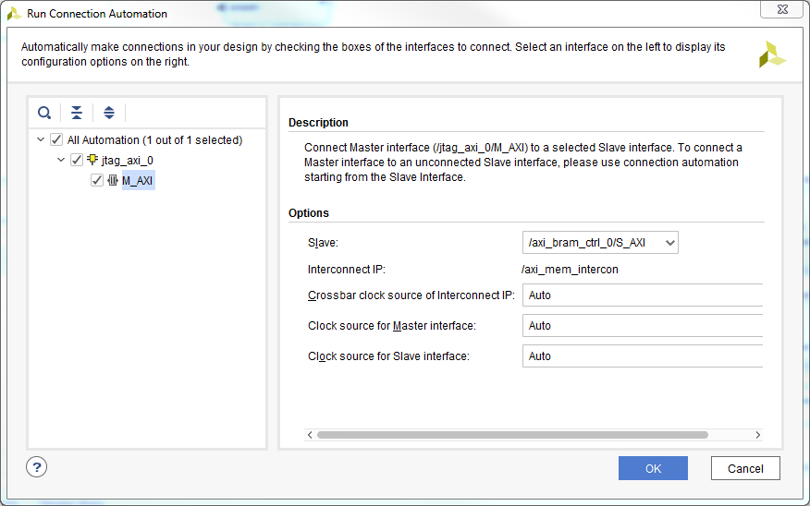
Vivado IP Integrator: Intelligent IP Integration
Correct-by-construction
Interface level connections
Extensible IP repository
Real-time DRCs and parameter propagation / resolution
Designer assistance

Slide 74
Reducing Run Time

Slide 75
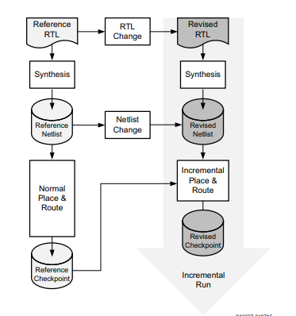
Design Check Points
Vivado uses a physical design database to store placement and routing information
Design checkpoint files (.dcp) allow you to save and restore this physical database at key points in the design flow

Slide 76
Vivado – Reducing Compile Time
Implementing a FPGA design can take a considerable time > 1 Hour
Iterating the design can therefore be an issue, there are several options which can reduce the implementation time both in synthesis and place and route
Synthesis
Global | Performs a traditional top-down synthesis of the entire design. Selecting this option takes the longest time because you need to re-run the entire synthesis every time you make a change.
Out of Context Per IP | Runs synthesis and creates a Design Check Point (DCP) for every individual IP block within your design. These check points are then collected into a black-box at the top-level implementation. Using this option means that only the blocks you change need to be re-synthesized, which saves time. OOC-IP also creates an IP customization file (XCI) for each IP block, allowing for customization and OOC XDC files. OOC-IP is the default setting for synthesis within Vivado. This option applies to all IP within the block diagram.
Out of Context Per Block Diagram | Like the OOC-IP option however this option allows you to define the entire block diagram as OOC

Slide 77
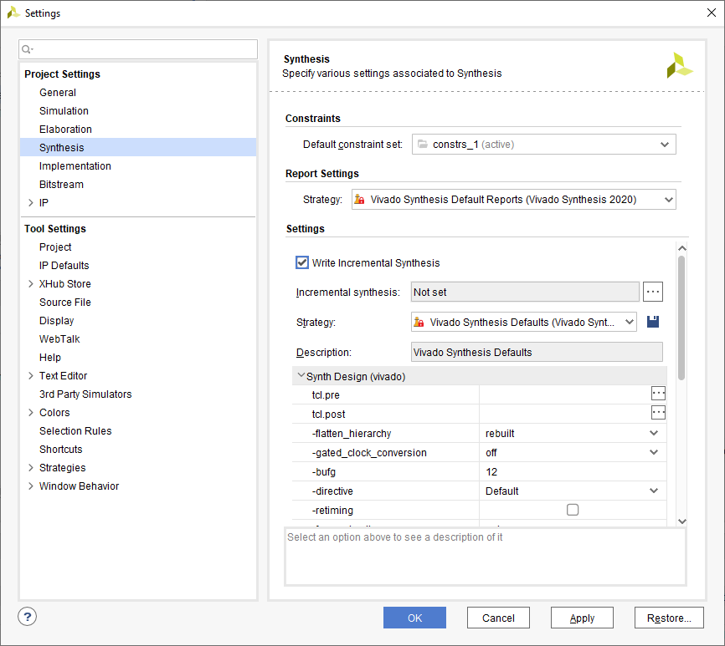
Vivado – Reducing Compile Time
Incremental synthesis can also be used when the changes are small
Write out incremental synthesis to the post synthesis design check point
Selecting incremental synthesis then provides two options
Automatically use previous DCP
Use a defined DCP

Slide 78
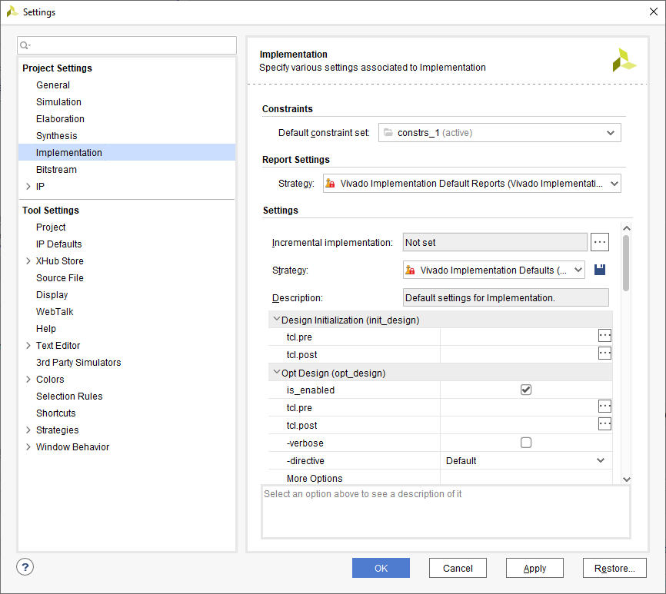
Vivado – Reducing Compile Time
Incremental implementation allows use of Design Check Point as the starting point
Preserves QoR predictability by reusing prior placement and routing from a reference design
Speeds up place and route run time or attempts last mile timing closure

Slide 79
Strategies and Reports

Slide 80
Vivado – Strategies
Strategies are a defined set of Vivado implementation feature options that control the implementation results.
These strategies can be used to explore:
Timing Performance (e.g., Performance_Explore)
Congestion - Strategies to reduce routing congestion in areas of the design
Area - Optimise for area
Power – Optimise for power
Quick Flow – Reduced implementation time
We should always of course try to achieve timing closure

Slide 81
Vivado – Reports
Vivado provides several reports which can be used to help focus in on performance issues in the design:
Design Analysis Report – Provides information on design timing, congestion, and complexity of design
Quality of Result Report – Provides overall design assessment and methodology check – QOR can also make suggestions to fix issues in the design.
Both are very useful to achieve timing closure of the design

Slide 82
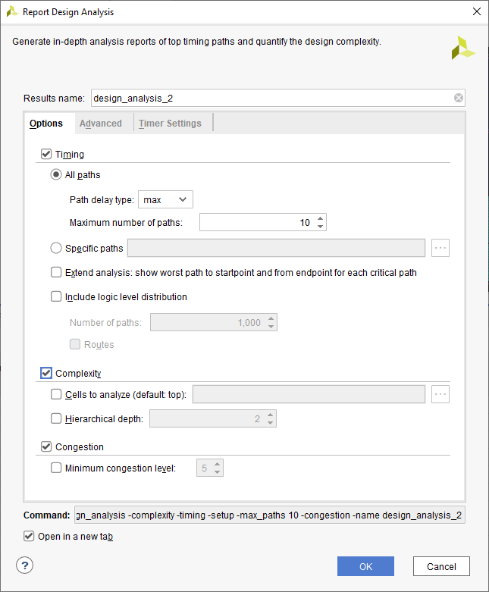
Vivado – Design Analysis Report
Design Analysis Report provides information on:
Timing – Provides information on the timing and physical characteristics of timing paths.
Complexity – Provides information on routing complexity and LUT distribution.
Congestion – Provides information on routing congestion
No need to run full implementation.
Generate report after running opt_design
command in TCL

Slide 83
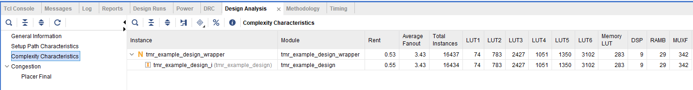
Vivado – Design Analysis Report
Along with timing information, DAR can provide information on design complexity including indicating design risk for implementation
Low Risk Rent Analysis <0.65 and Fan Out <4
High Risk Rent Analysis >0.65 <0.85 and Fan Out >4 % <5 – May be difficult to place without congestion
Very High Risk, Rent Analysis >0.85 and Fan Out >5 – May not implement

Slide 84
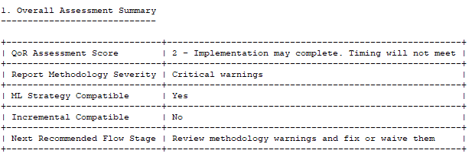
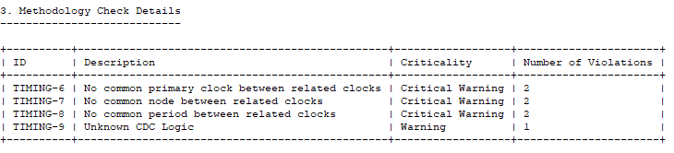
Vivado – Quality of Result
Quality of Result Assessment (QoRA) and Quality of Result Suggestions (QoRS) since both provide information that can be used to achieve timing closure
Like Design Analysis Report – Run initially after doing the Opt

Slide 85
Vivado – Quality of Results

Slide 86

Vivado – Quality of Results

Slide 87
Verification

Slide 88
Verification
Before we can deploy an FPGA based solution we must be sure it functions as expected, across all use cases. This is where verification and validation come in, for those unfamiliar with the terms
Verification – Does the FPGA function in line with the specification
Validation – Is the specification correct i.e. does it address the needs of the use case.
While validation takes place mostly within the higher levels of system engineering domain, verification takes place at the FPGA level. Depending upon the needs of the applications verification can range from being very complex and time consuming to simply confirming the expected behaviour.
At the heart of verification is simulation and the simulator.

Slide 89

Simulation

Slide 90
Simulation
Verification can be used at several different levels
Functional Simulation only – This check if the design is functionally correct
Functional Simulation & Code Coverage – This checks that along with the functional correctness of the design that, all of the code within the design has been tested.
Gate Level Simulation – This verifies the functionality of the design when back annotated with timing information from the final implemented design, this can take a considerable time to perform.

Slide 91
Verification What else can we do?
Static Timing Analysis – This analyses the final design to ensure the timing performance of the module is achieved.
Formal Equivalence Checking - This is used to check the equivalence of netlists against RTL files

Slide 92


www.adiuvoengineering.com
adam@adiuvoengineering.com

